Slide 1

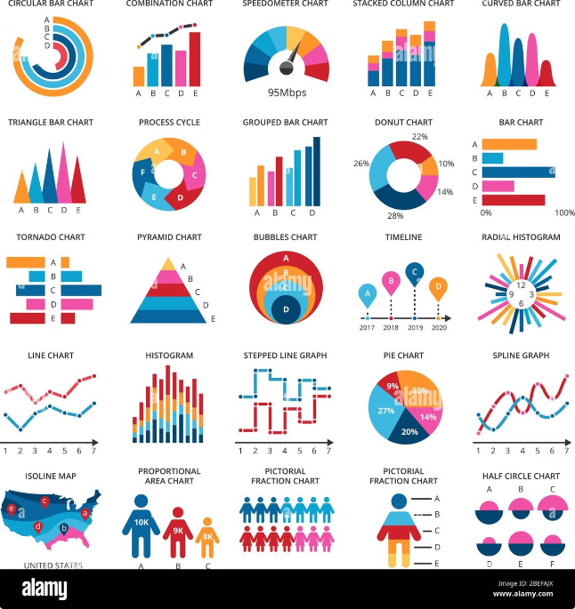
Expense Tracker Project
Welcome to the presentation of our Expense Tracker project, a comprehensive web application designed to help users effectively manage their personal or business finances. This presentation will explore the project's design, functionalities, and technologies used.
By:- NIMISH KUMAR

Slide 2
Overview of Technologies Used
JSP
Servlet
Hibernate
JSP (JavaServer Pages) provides the foundation for the application's dynamic web pages. It allows for the integration of Java code with HTML, resulting in interactive and data-driven web pages.
Servlets act as the backend controllers, handling user requests and processing data. They communicate with the database through Hibernate and generate responses that are sent back to the client.
Hibernate is an object-relational mapping framework that simplifies the interaction between Java objects and the database. It maps Java classes to database tables, abstracting away the complexities of SQL.

Slide 3

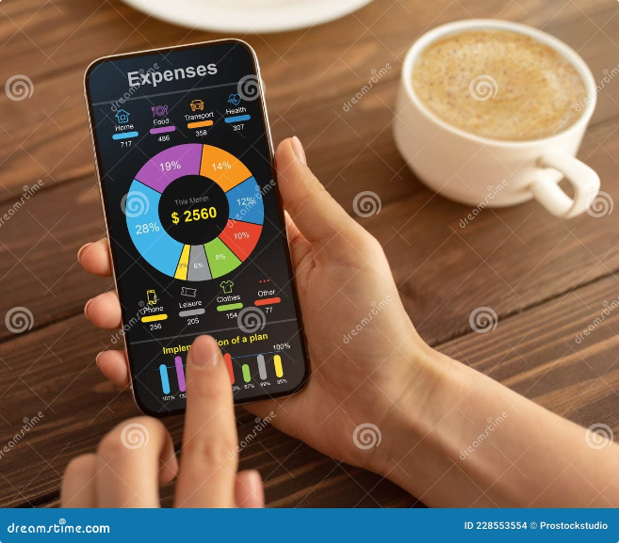
Project Objectives and Key Features
1
User-Friendly Interface
2
Comprehensive Expense Tracking
The application prioritizes user experience by providing a simple and intuitive interface, making it easy for users to track their expenses.
Users can categorize expenses, add descriptions, and track spending by date, category, or vendor.
3
Detailed Reporting and Analysis
4
Secure Data Storage
The database is designed with security in mind to protect sensitive financial information, ensuring user privacy.
The application generates reports that provide insights into spending habits, allowing users to identify areas for improvement.

Slide 4

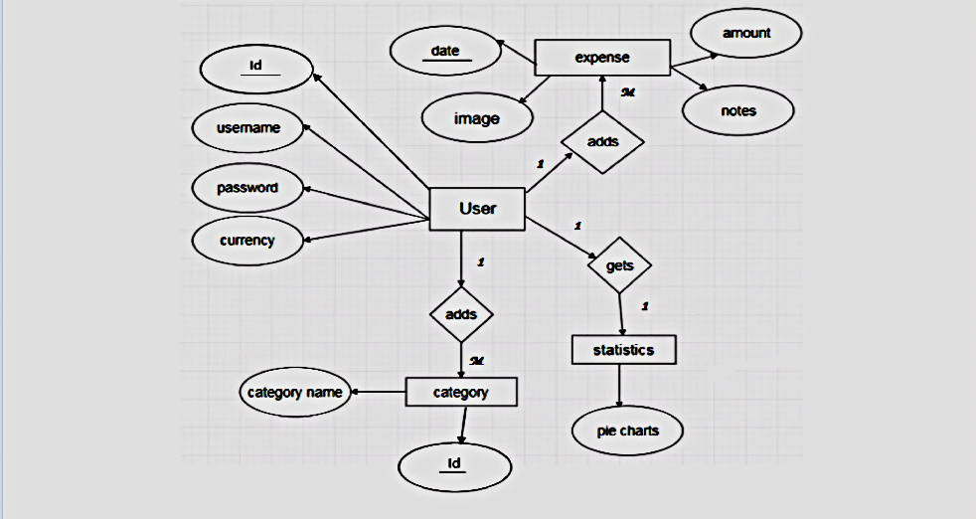
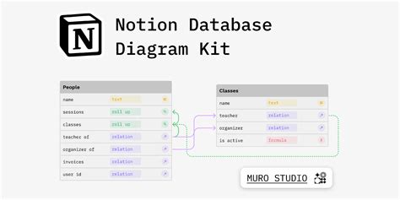
Database Design and Entity Relationships
Entity
Attributes
Relationships
User
Username, Password, Email
One-to-Many with Expenses
Category
Name, Description
Many-to-Many with Expenses
Expense
Date, Amount, Description, Category
Many-to-One with User, Many-to-Many with Category

Slide 5

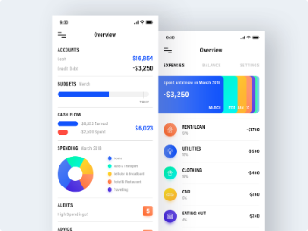




User Interface and Functionality Walkthrough
Login/Registration
Expense Entry
Expense List
Reports
Users can create an account or log in to access their expense records.
A simple form allows users to input details of their expenses, including amount, date, category, and description.
The expense list displays all recorded expenses, allowing users to filter and sort expenses by date, category, or amount.
Users can generate reports to visualize their expenses and gain insights into spending patterns.

Slide 6

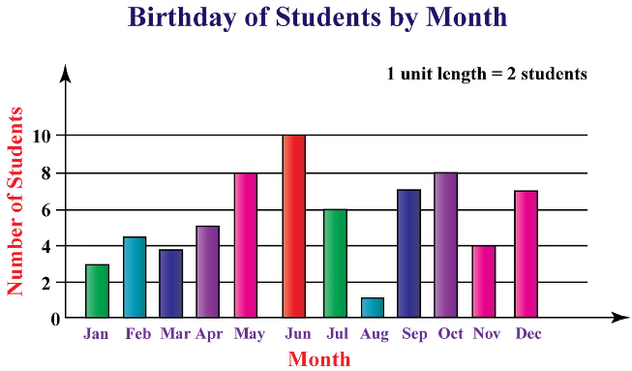
Expense Management and Reporting Capabilities
Budgeting
Categorization
Users can set budget limits for different categories and monitor their progress toward achieving their financial goals.
Detailed categorization helps users understand where their money is going, allowing them to make informed decisions about their spending.
Reporting
Historical Trends
Reports offer a variety of visualization options, such as bar charts, line graphs, and pie charts, to effectively present financial data.
Users can analyze past spending patterns to identify recurring expenses and make adjustments to their budgets.

Slide 7






Challenges and Lessons Learned during Development
Bug Fixing
Database Optimization
Debugging complex web applications can be time-consuming. Careful testing and code reviews are essential to minimize errors.
Efficient database design and query optimization are crucial for performance, especially with large datasets.
Security Measures
Team Collaboration
Implementing strong security measures is essential to protect sensitive financial data from unauthorized access.
Effective communication and teamwork are key to successful software development, ensuring all team members are on the same page.

Slide 8


Future Enhancements and Conclusion
1
Mobile App Development
Developing a companion mobile app would provide users with on-the-go access to their expense records and reporting.
2
Integration with Financial Institutions
Enabling direct bank account connections would streamline expense tracking and eliminate manual data entry.
3
Advanced Analytics
Implementing machine learning algorithms could provide personalized financial insights and recommendations to help users manage their finances effectively.

Slide 9
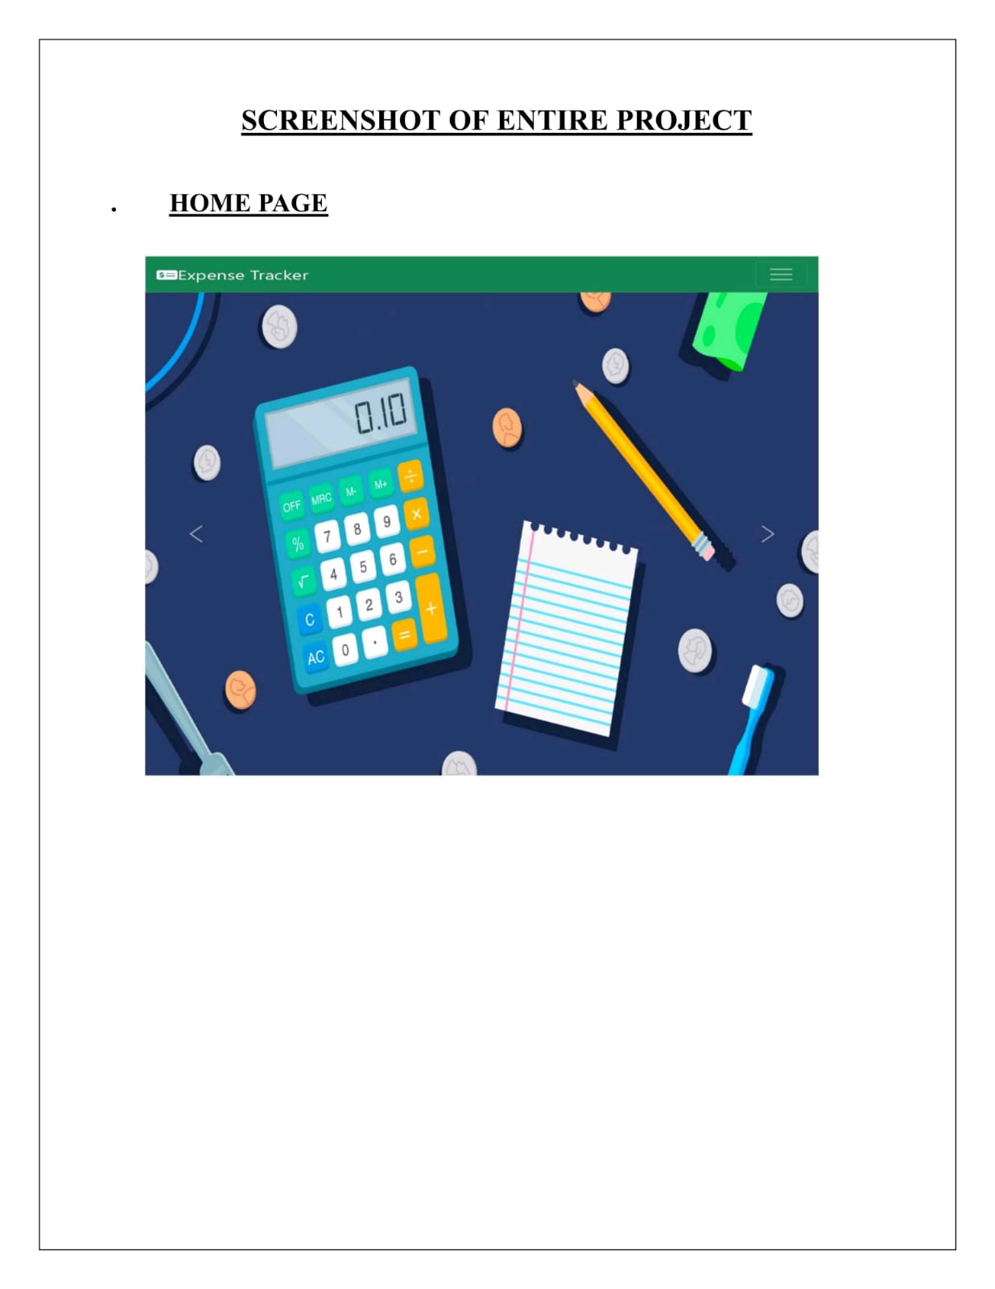

Slide 10
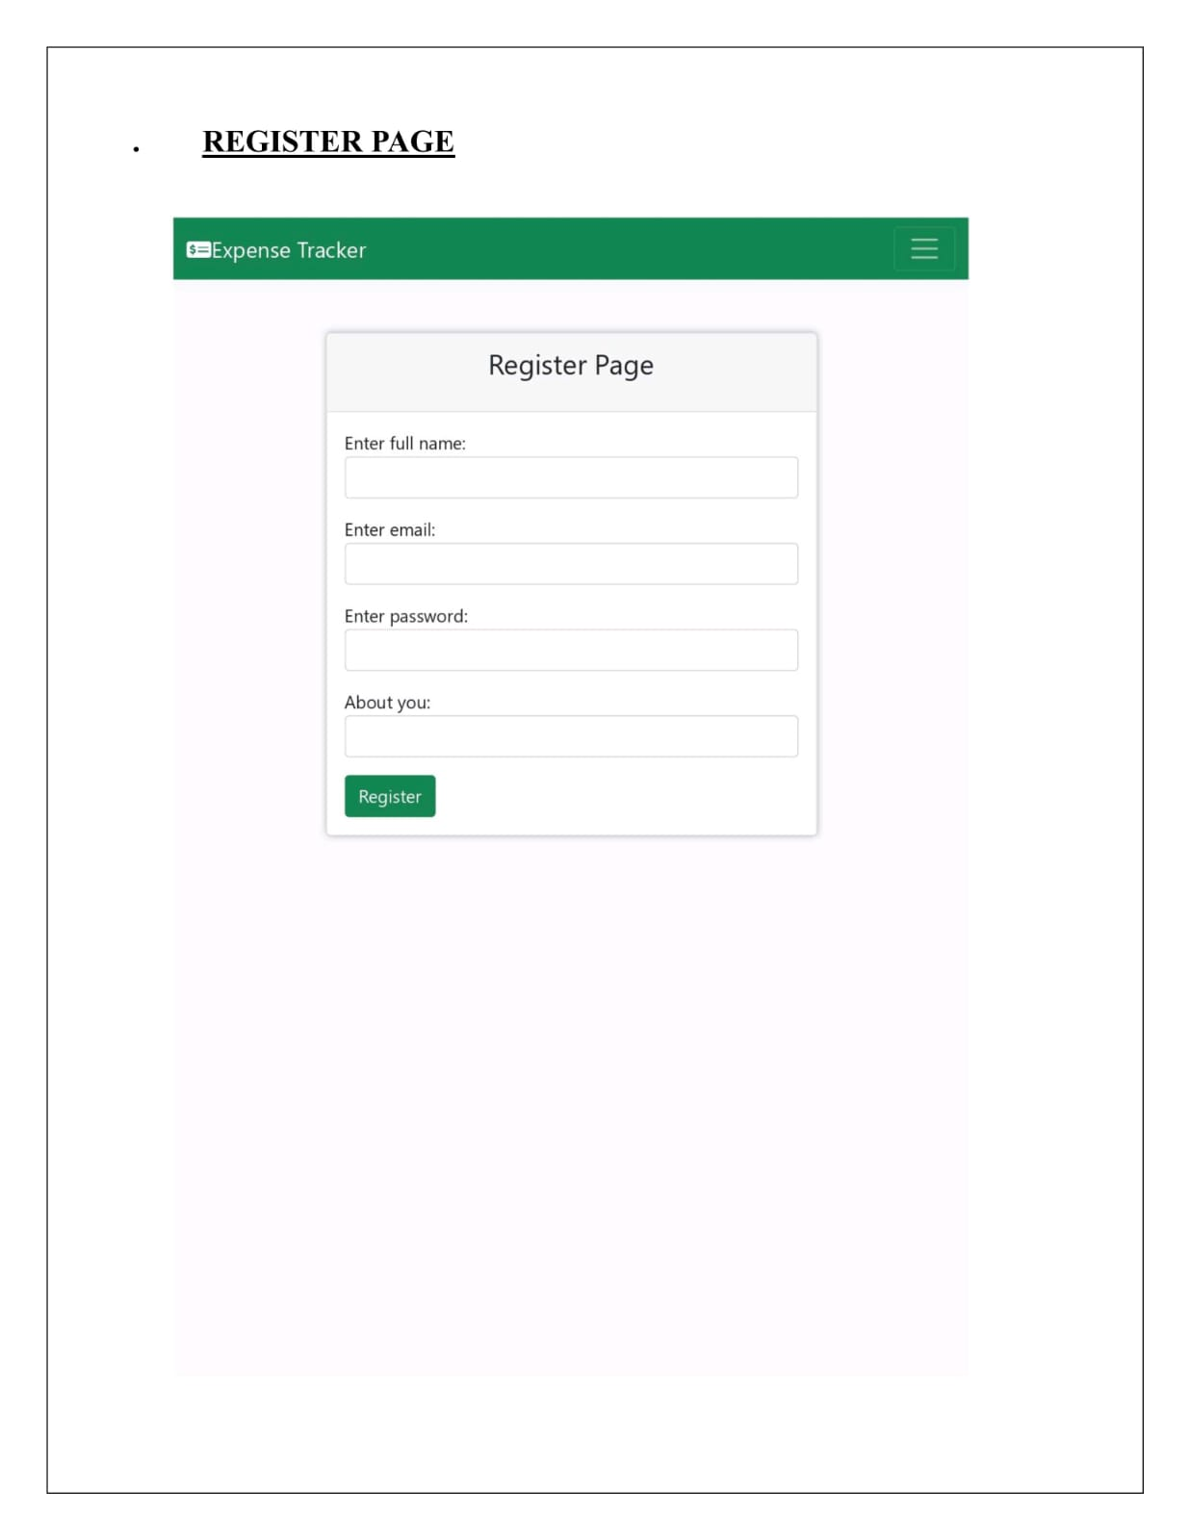

Slide 11
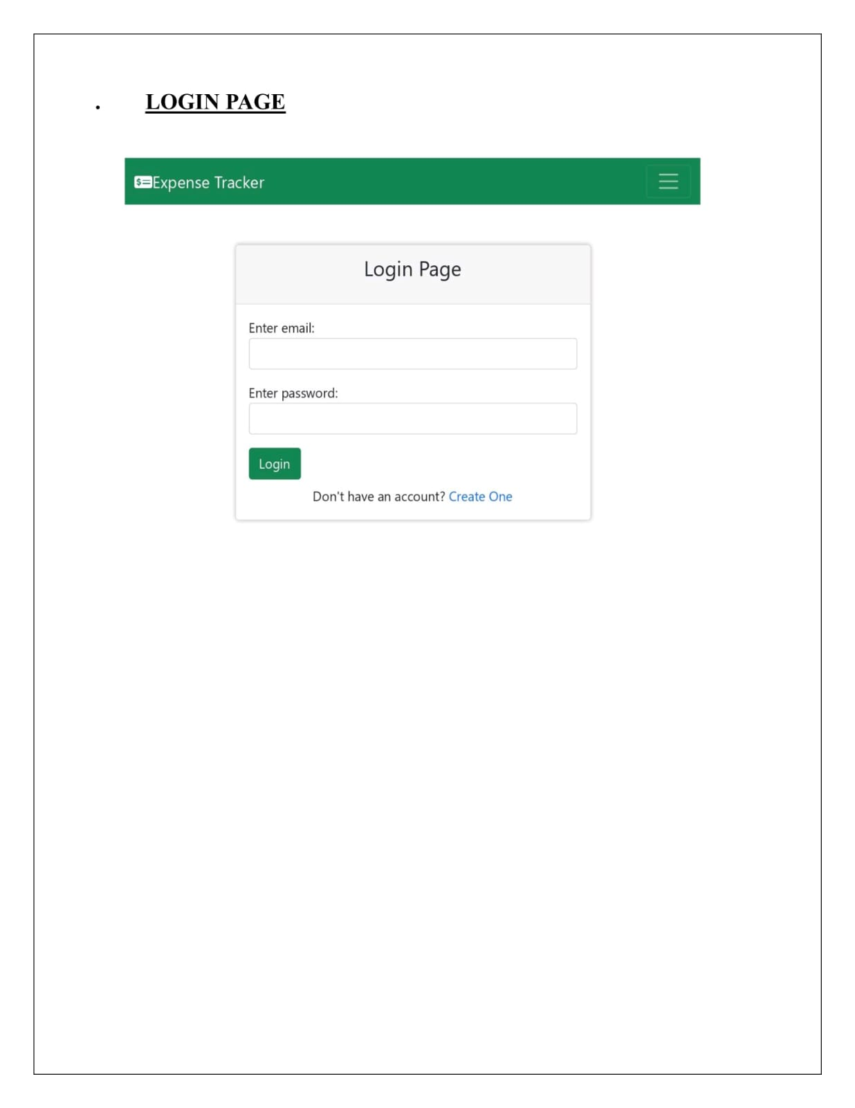

Slide 12
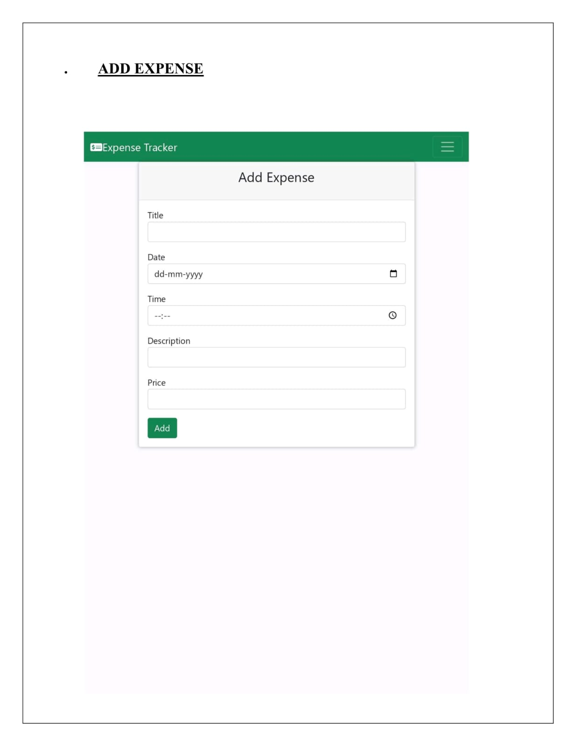

Slide 13
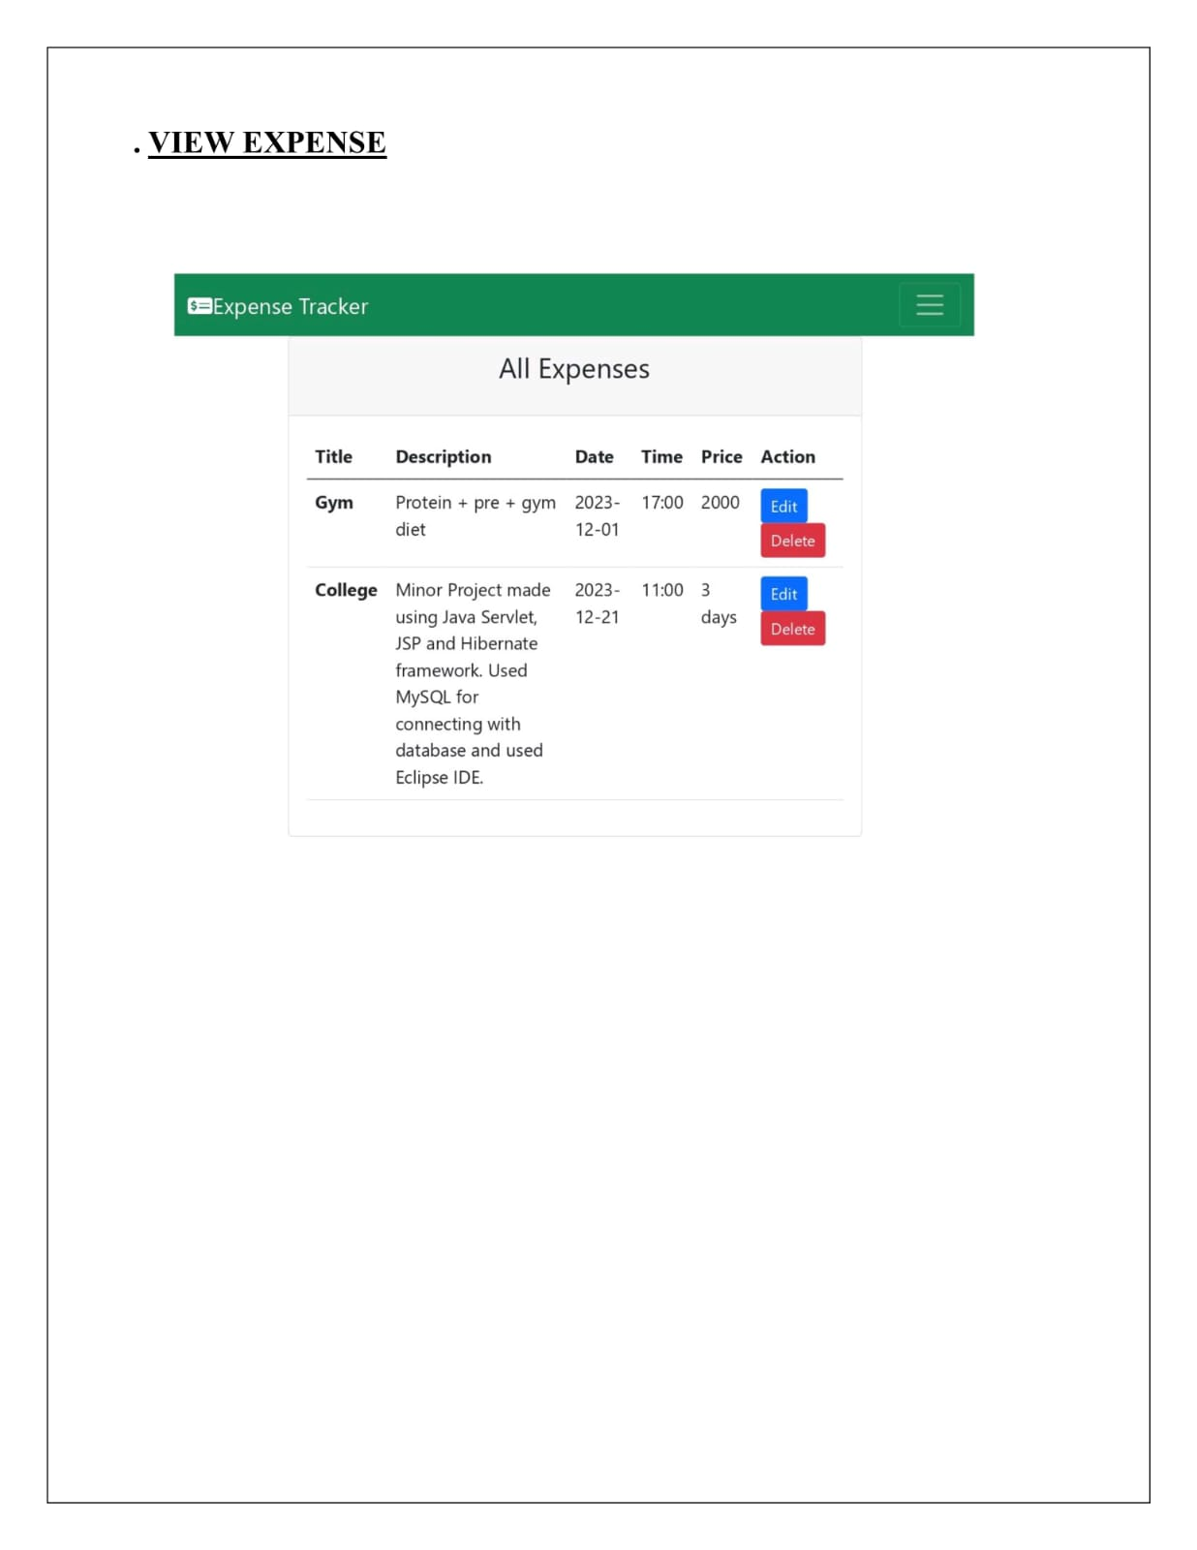

Slide 14
Expense Tracker Project
Thank You
By:- NIMISH KUMAR

